Slide 1





Test Driven Development Tutorial
Object Mentor, Inc.
www.objectmentor.com
www.pairprogramming.com
www.xprogramming.com
www.junit.org
Copyright © 1998-2001 by Object Mentor, Inc
All Rights Reserved

Slide 2


Craftsmanship
What this course is really about.
  Attitude.
  Keeping code clean
  Keeping code tested.
  Being professional.
  Green Band.

Slide 3


Yeah, but…
Too expensive…
  We should talk about TCO!
Takes too long…
  What if you didn’t have to debug?
Time to market…
  Best achieved by working well.
No way “they” will let us!
  Indeed, “they” expect professionalism.

Slide 4
The Three Laws of TDD
Write no production code unless you have a failing unit test.
Do not write more of a unit test than is sufficient to fail. (And not compiling is failing.)
Do not write more production code than is sufficient to pass.
Rinse and repeat every minute.

Slide 5
The Litany of Benefits
When we work this way:
  Debug time drops close to zero.
  We can refactor!
    TESTS! Are what make code flexible!!!
  We have formal design documents.
  Our code is decoupled.

Slide 6

Lots of Small Steps
Shortest distance between two points
B1
A
B
Use test-first to get from A in small verifiable steps to where you really need to be
Do you always end up where you expected you were going?

Slide 7
Craftsmanship and Professionalism
We promise to test our code.
  All of our code.
  All of the time.
The Green Band.

Slide 8

What is Tested?
Every class must have one or more unit tests.
  Test everything that can possibly break.
If it can’t break, don’t test it.
  Can this fail ?
String getName() {
return name;
}

Slide 9
Objections Heard (but not believed)
“I know how to just write the class, but I don’t know how to test it.”
“We have to write twice as much code and provide two people to do it.”
“I have to debug twice as much code.”
“We have a testing department.”
“I can test my code after I write it.”

Slide 10
Writing Automated
Acceptance Tests
Object Mentor, Inc.
Copyright © 1998-2001 by Object Mentor, Inc
All Rights Reserved

Slide 11
The Role of QA in an Agile Project

Slide 12
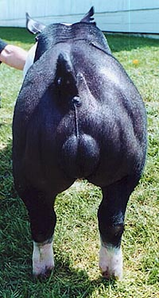
The Traditional schedule for Quality.
Waiting at the sphincter muscle.
1 May
1 Jul
1 Sep
1 Nov
Analysis
Design
Implementation
Test

Slide 13
When Quality comes at the end.
It is under the most pressure.
It has the least flexibility.
It is a high stress tedious job.
It is error prone.
Quality cannot be tested in.

Slide 14
The Agile View:
Quality is a specification role…
…not a verification role!

Slide 15
A feature is not specified…
Until it’s acceptance test is written.

Slide 16
Who Writes Acceptance Tests?
Business Analysts
  Happy path.
QA Test Writers, and Testers
  Corner and boundary cases.
    Try to break it.

Slide 17

Acceptance Tests Are…
Automated.
  written in a very high level language.
  executed frequently.
  written by the stakeholders.

Slide 18

Imagine you have a button to press that would tell you if the system worked
How often would you press it?

Slide 19
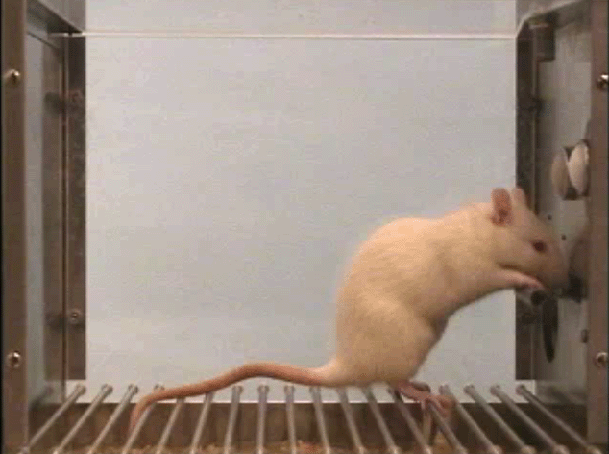
It becomes a conditioned response.

Slide 20
When is the best time to write Automated Acceptance Tests?

Slide 21
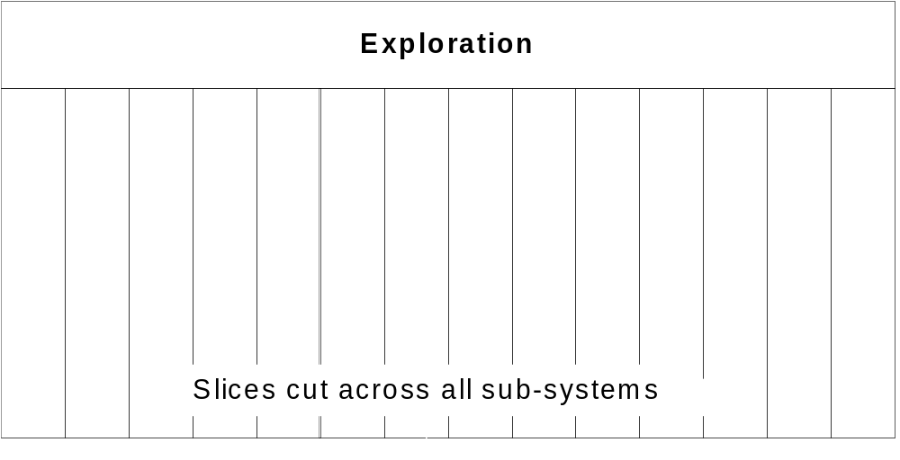
At the start of each iteration.
Test

Slide 22
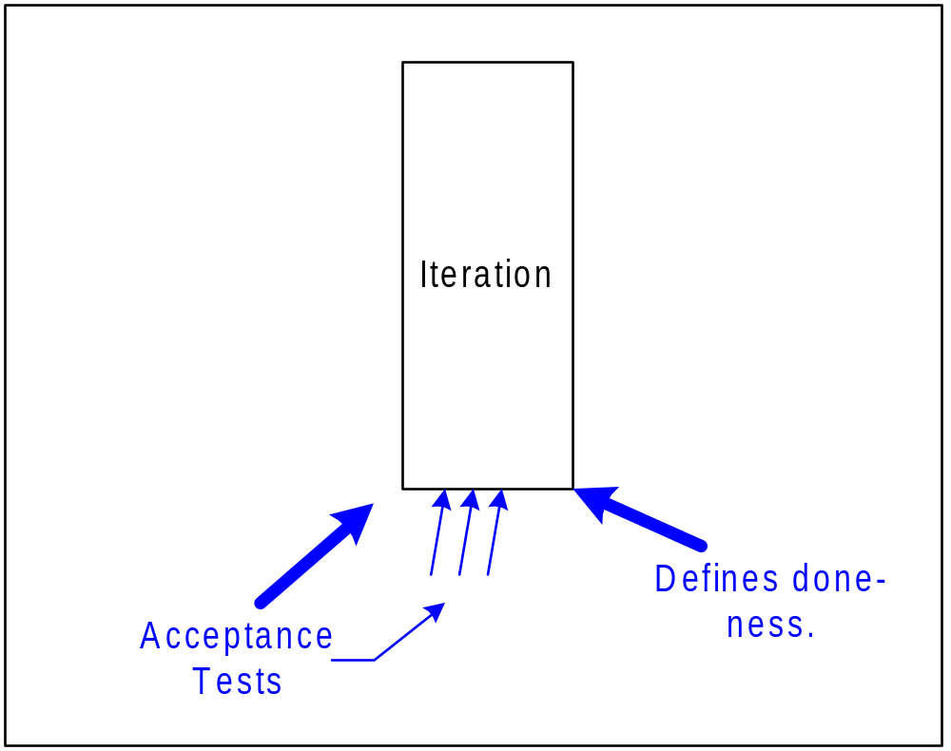
Tests specify each iteration.

Slide 23
What do they look like?

Slide 24
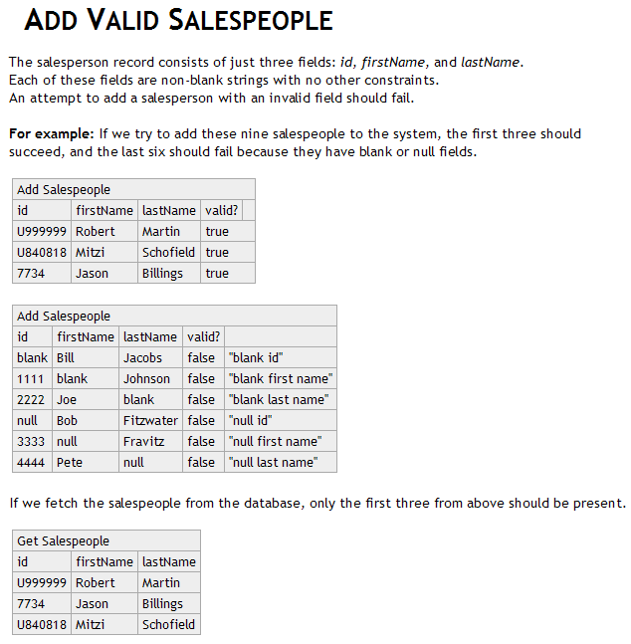
A Simple
Example

Slide 25
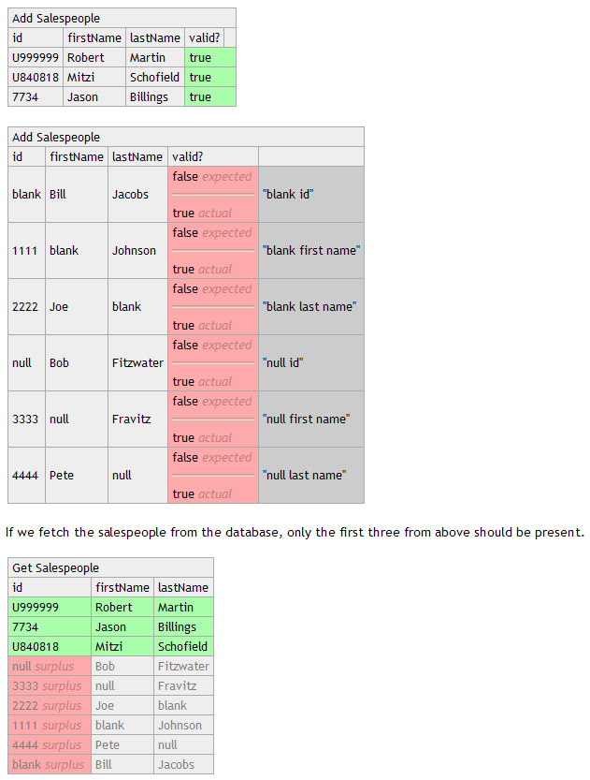
The result.

Slide 26
FitNesse
The solution we all agreed upon.

Slide 27
Writing Requirements as Tests
Requirements are written with example tables.
The tables are really tests.
Writing tests as a table is an interesting paradigm
  Some tests naturally fit into tables
  Some tests require thought to put them in the form of a table
Notes:
<footer>Copyright © 1999-2001 by Object Mentor, Inc
All Rights Reserved

Slide 28
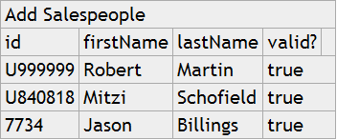
The Mechanics
The first row of a FIT table is the title of the table.
This title is the name of something called a “fixture”.
Fixtures are simple programs written by the developers to connect the application to the data in the table.
Notes:
<footer>Copyright © 1999-2001 by Object Mentor, Inc
All Rights Reserved

Slide 29
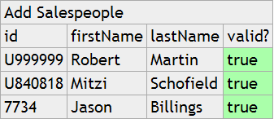
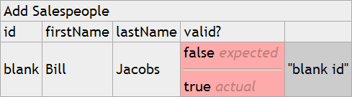
The Mechanics
When you run a test the fixture gathers the data from the table and calls the appropriate functions in the application.
The fixture then gathers data from the application and compares them with entries in the table, turning them green or red.
Notes:
<footer>Copyright © 1999-2001 by Object Mentor, Inc
All Rights Reserved

Slide 30
Acceptance Testing with Fit/FitNesse
Fit Fixtures
Fit/FitNesse
UI
The Application Interface
The Application
Logic

Slide 31
The Test-Bus Imperative

Slide 32
Many Industries build testability in.
Telecommunications
Manufacturing
Electronic Hardware

Slide 33
But not the software industry.
Testability is almost always an afterthought
If it is thought of at all.

Slide 34






Untestable Dependencies.
Too often applications directly depend on external and third party resources.
Network
READY

Slide 35
Dependency Management
Interfaces isolate the system from external dependencies.
Network
READY

Slide 36
Testability!
Tests and
Simulations
Tests and
Simulations
Tests and
Simulations

Slide 37
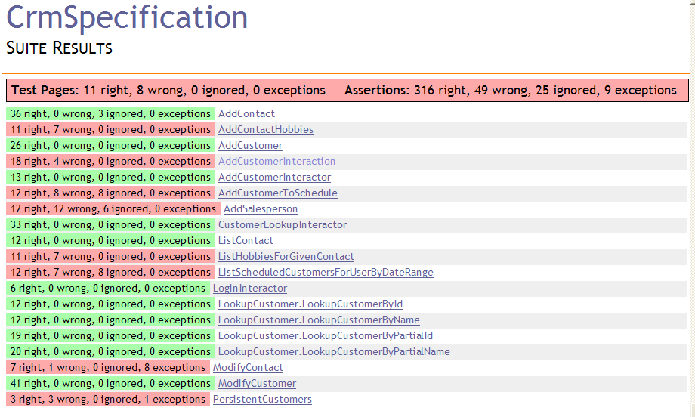
Iteration Management

Slide 38
Contact Information
Robert C. Martin unclebob@objectmentor.com
Website: www.objectmentor.com
BLOG: blog.objectmentor.com
FitNesse: www.fitnesse.org
Green Band: (one only!)
  Send self-addressed-stamped-envelope to:
      Green Wrist Band
      Object Mentor Inc.
      1800 Nations Drive
      Suite 215
      Gurnee, IL, 60031

Slide 39
Bowling Game Kata
Copyright © 2005 by Object Mentor, Inc
All copies must retain this page unchanged.

Slide 40
Scoring Bowling.
The game consists of 10 frames as shown above. In each frame the player has
two opportunities to knock down 10 pins. The score for the frame is the total
number of pins knocked down, plus bonuses for strikes and spares.
A spare is when the player knocks down all 10 pins in two tries. The bonus for
that frame is the number of pins knocked down by the next roll. So in frame 3
above, the score is 10 (the total number knocked down) plus a bonus of 5 (the
number of pins knocked down on the next roll.)
A strike is when the player knocks down all 10 pins on his first try. The bonus
for that frame is the value of the next two balls rolled.
In the tenth frame a player who rolls a spare or strike is allowed to roll the extra
balls to complete the frame. However no more than three balls can be rolled in
tenth frame.
Notes:
<footer>Copyright © 1999-2001 by Object Mentor, Inc
All Rights Reserved

Slide 41

The Requirements.
Write a class named “Game” that has two methods
  roll(pins : int) is called each time the player rolls a ball. The argument is the number of pins knocked down.
  score() : int is called only at the very end of the game. It returns the total score for that game.
Notes:
<footer>Copyright © 1999-2001 by Object Mentor, Inc
All Rights Reserved

Slide 42

A quick design session
Clearly we need the Game class.
Notes:
<footer>Copyright © 1999-2001 by Object Mentor, Inc
All Rights Reserved

Slide 43

A quick design session
A game has 10 frames.
Notes:
<footer>Copyright © 1999-2001 by Object Mentor, Inc
All Rights Reserved

Slide 44

A quick design session
A frame has 1 or two rolls.
Notes:
<footer>Copyright © 1999-2001 by Object Mentor, Inc
All Rights Reserved

Slide 45

A quick design session
The tenth frame has two or three rolls.
It is different from all the other frames.
Notes:
<footer>Copyright © 1999-2001 by Object Mentor, Inc
All Rights Reserved

Slide 46

A quick design session
The score function must
iterate through all the
frames, and calculate
all their scores.
Notes:
<footer>Copyright © 1999-2001 by Object Mentor, Inc
All Rights Reserved

Slide 47

A quick design session
The score for a spare or a strike depends on the frame’s successor
Notes:
<footer>Copyright © 1999-2001 by Object Mentor, Inc
All Rights Reserved

Slide 48
Begin.
Create a project named BowlingGame
Create a unit test named BowlingGameTest
import junit.framework.TestCase;
public class BowlingGameTest extends TestCase {
}
Notes:
<footer>Copyright © 1999-2001 by Object Mentor, Inc
All Rights Reserved

Slide 49
Begin.
Create a project named BowlingGame
Create a unit test named BowlingGameTest
import junit.framework.TestCase;
public class BowlingGameTest extends TestCase {
}
Execute this program and verify that you get the following error:
No tests found in BowlingGameTest
Notes:
<footer>Copyright © 1999-2001 by Object Mentor, Inc
All Rights Reserved

Slide 50
The first test.
import junit.framework.TestCase;
public class BowlingGameTest extends TestCase {
public void testGutterGame() throws Exception {
Game g = new Game();
}
}
Notes:
<footer>Copyright © 1999-2001 by Object Mentor, Inc
All Rights Reserved

Slide 51
The first test.
import junit.framework.TestCase;
public class BowlingGameTest extends TestCase {
public void testGutterGame() throws Exception {
Game g = new Game();
}
}
public class Game {
}
Notes:
<footer>Copyright © 1999-2001 by Object Mentor, Inc
All Rights Reserved

Slide 52
The first test.
import junit.framework.TestCase;
public class BowlingGameTest extends TestCase {
public void testGutterGame() throws Exception {
Game g = new Game();
}
}
public class Game {
}
Notes:
<footer>Copyright © 1999-2001 by Object Mentor, Inc
All Rights Reserved

Slide 53
The first test.
import junit.framework.TestCase;
public class BowlingGameTest extends TestCase {
public void testGutterGame() throws Exception {
Game g = new Game();
for (int i=0; i<20; i++)
g.roll(0);
}
}
public class Game {
}
Notes:
<footer>Copyright © 1999-2001 by Object Mentor, Inc
All Rights Reserved

Slide 54
The first test.
import junit.framework.TestCase;
public class BowlingGameTest extends TestCase {
public void testGutterGame() throws Exception {
Game g = new Game();
for (int i=0; i<20; i++)
g.roll(0);
}
}
public class Game {
public void roll(int pins) {
}
}
Notes:
<footer>Copyright © 1999-2001 by Object Mentor, Inc
All Rights Reserved

Slide 55
The first test.
import junit.framework.TestCase;
public class BowlingGameTest extends TestCase {
public void testGutterGame() throws Exception {
Game g = new Game();
for (int i=0; i<20; i++)
g.roll(0);
assertEquals(0, g.score());
}
}
public class Game {
public void roll(int pins) {
}
}
Notes:
<footer>Copyright © 1999-2001 by Object Mentor, Inc
All Rights Reserved

Slide 56
The first test.
import junit.framework.TestCase;
public class BowlingGameTest extends TestCase {
public void testGutterGame() throws Exception {
Game g = new Game();
for (int i=0; i<20; i++)
g.roll(0);
assertEquals(0, g.score());
}
}
public class Game {
public void roll(int pins) {
}
public int score() {
return -1;
}
}
expected:<0> but was:<-1>
Notes:
<footer>Copyright © 1999-2001 by Object Mentor, Inc
All Rights Reserved

Slide 57
The first test.
import junit.framework.TestCase;
public class BowlingGameTest extends TestCase {
public void testGutterGame() throws Exception {
Game g = new Game();
for (int i=0; i<20; i++)
g.roll(0);
assertEquals(0, g.score());
}
}
public class Game {
public void roll(int pins) {
}
public int score() {
return 0;
}
}
Notes:
<footer>Copyright © 1999-2001 by Object Mentor, Inc
All Rights Reserved

Slide 58
The Second test.
import junit.framework.TestCase;
public class BowlingGameTest extends TestCase {
public void testGutterGame() throws Exception {
Game g = new Game();
for (int i = 0; i < 20; i++)
g.roll(0);
assertEquals(0, g.score());
}
public void testAllOnes() throws Exception {
Game g = new Game();
for (int i = 0; i < 20; i++)
g.roll(1);
assertEquals(20, g.score());
}
}
public class Game {
public void roll(int pins) {
}
public int score() {
return 0;
}
}
Notes:
<footer>Copyright © 1999-2001 by Object Mentor, Inc
All Rights Reserved

Slide 59
The Second test.
- Game creation is duplicated
- roll loop is duplicated
import junit.framework.TestCase;
public class BowlingGameTest extends TestCase {
public void testGutterGame() throws Exception {
Game g = new Game();
for (int i = 0; i < 20; i++)
g.roll(0);
assertEquals(0, g.score());
}
public void testAllOnes() throws Exception {
Game g = new Game();
for (int i = 0; i < 20; i++)
g.roll(1);
assertEquals(20, g.score());
}
}
public class Game {
public void roll(int pins) {
}
public int score() {
return 0;
}
}
Notes:
<footer>Copyright © 1999-2001 by Object Mentor, Inc
All Rights Reserved

Slide 60
The Second test.
- Game creation is duplicated
- roll loop is duplicated
import junit.framework.TestCase;
public class BowlingGameTest extends TestCase {
public void testGutterGame() throws Exception {
Game g = new Game();
for (int i = 0; i < 20; i++)
g.roll(0);
assertEquals(0, g.score());
}
public void testAllOnes() throws Exception {
Game g = new Game();
for (int i = 0; i < 20; i++)
g.roll(1);
assertEquals(20, g.score());
}
}
public class Game {
public void roll(int pins) {
}
public int score() {
return 0;
}
}
expected:<20> but was:<0>
Notes:
<footer>Copyright © 1999-2001 by Object Mentor, Inc
All Rights Reserved

Slide 61
The Second test.
- roll loop is duplicated
import junit.framework.TestCase;
public class BowlingGameTest extends TestCase {
private Game g;
protected void setUp() throws Exception {
g = new Game();
}
public void testGutterGame() throws Exception {
for (int i = 0; i < 20; i++)
g.roll(0);
assertEquals(0, g.score());
}
public void testAllOnes() throws Exception {
for (int i = 0; i < 20; i++)
g.roll(1);
assertEquals(20, g.score());
}
}
public class Game {
private int score = 0;
public void roll(int pins) {
score += pins;
}
public int score() {
return score;
}
}
Notes:
<footer>Copyright © 1999-2001 by Object Mentor, Inc
All Rights Reserved

Slide 62
The Second test.
- roll loop is duplicated
import junit.framework.TestCase;
public class BowlingGameTest extends TestCase {
private Game g;
protected void setUp() throws Exception {
g = new Game();
}
public void testGutterGame() throws Exception {
int n = 20;
int pins = 0;
for (int i = 0; i < n; i++) {
g.roll(pins);
}
assertEquals(0, g.score());
}
public void testAllOnes() throws Exception {
for (int i = 0; i < 20; i++)
g.roll(1);
assertEquals(20, g.score());
}
}
public class Game {
private int score = 0;
public void roll(int pins) {
score += pins;
}
public int score() {
return score;
}
}
Notes:
<footer>Copyright © 1999-2001 by Object Mentor, Inc
All Rights Reserved

Slide 63
The Second test.
- roll loop is duplicated
import junit.framework.TestCase;
public class BowlingGameTest extends TestCase {
private Game g;
protected void setUp() throws Exception {
g = new Game();
}
public void testGutterGame() throws Exception {
int n = 20;
int pins = 0;
rollMany(n, pins);
assertEquals(0, g.score());
}
private void rollMany(int n, int pins) {
for (int i = 0; i < n; i++)
g.roll(pins);
}
public void testAllOnes() throws Exception {
for (int i = 0; i < 20; i++)
g.roll(1);
assertEquals(20, g.score());
}
}
public class Game {
private int score = 0;
public void roll(int pins) {
score += pins;
}
public int score() {
return score;
}
}
Notes:
<footer>Copyright © 1999-2001 by Object Mentor, Inc
All Rights Reserved

Slide 64
The Second test.
- roll loop is duplicated
import junit.framework.TestCase;
public class BowlingGameTest extends TestCase {
private Game g;
protected void setUp() throws Exception {
g = new Game();
}
public void testGutterGame() throws Exception {
rollMany(20, 0);
assertEquals(0, g.score());
}
private void rollMany(int n, int pins) {
for (int i = 0; i < n; i++)
g.roll(pins);
}
public void testAllOnes() throws Exception {
for (int i = 0; i < 20; i++)
g.roll(1);
assertEquals(20, g.score());
}
}
public class Game {
private int score = 0;
public void roll(int pins) {
score += pins;
}
public int score() {
return score;
}
}
Notes:
<footer>Copyright © 1999-2001 by Object Mentor, Inc
All Rights Reserved

Slide 65
The Second test.
- roll loop is duplicated
import junit.framework.TestCase;
public class BowlingGameTest extends TestCase {
private Game g;
protected void setUp() throws Exception {
g = new Game();
}
public void testGutterGame() throws Exception {
rollMany(20, 0);
assertEquals(0, g.score());
}
private void rollMany(int n, int pins) {
for (int i = 0; i < n; i++)
g.roll(pins);
}
public void testAllOnes() throws Exception {
rollMany(20,1);
assertEquals(20, g.score());
}
}
public class Game {
private int score = 0;
public void roll(int pins) {
score += pins;
}
public int score() {
return score;
}
}
Notes:
<footer>Copyright © 1999-2001 by Object Mentor, Inc
All Rights Reserved

Slide 66
The Second test.
import junit.framework.TestCase;
public class BowlingGameTest extends TestCase {
private Game g;
protected void setUp() throws Exception {
g = new Game();
}
private void rollMany(int n, int pins) {
for (int i = 0; i < n; i++)
g.roll(pins);
}
public void testGutterGame() throws Exception {
rollMany(20, 0);
assertEquals(0, g.score());
}
public void testAllOnes() throws Exception {
rollMany(20,1);
assertEquals(20, g.score());
}
}
public class Game {
private int score = 0;
public void roll(int pins) {
score += pins;
}
public int score() {
return score;
}
}
Notes:
<footer>Copyright © 1999-2001 by Object Mentor, Inc
All Rights Reserved

Slide 67
The Third test.
- ugly comment in test.
import junit.framework.TestCase;
public class BowlingGameTest extends TestCase {
private Game g;
protected void setUp() throws Exception {
g = new Game();
}
private void rollMany(int n, int pins) {
for (int i = 0; i < n; i++)
g.roll(pins);
}
public void testGutterGame() throws Exception {
rollMany(20, 0);
assertEquals(0, g.score());
}
public void testAllOnes() throws Exception {
rollMany(20,1);
assertEquals(20, g.score());
}
public void testOneSpare() throws Exception {
g.roll(5);
g.roll(5); // spare
g.roll(3);
rollMany(17,0);
assertEquals(16,g.score());
}
}
public class Game {
private int score = 0;
public void roll(int pins) {
score += pins;
}
public int score() {
return score;
}
}
Notes:
<footer>Copyright © 1999-2001 by Object Mentor, Inc
All Rights Reserved

Slide 68
The Third test.
- ugly comment in test.
import junit.framework.TestCase;
public class BowlingGameTest extends TestCase {
private Game g;
protected void setUp() throws Exception {
g = new Game();
}
private void rollMany(int n, int pins) {
for (int i = 0; i < n; i++)
g.roll(pins);
}
public void testGutterGame() throws Exception {
rollMany(20, 0);
assertEquals(0, g.score());
}
public void testAllOnes() throws Exception {
rollMany(20,1);
assertEquals(20, g.score());
}
public void testOneSpare() throws Exception {
g.roll(5);
g.roll(5); // spare
g.roll(3);
rollMany(17,0);
assertEquals(16,g.score());
}
}
public class Game {
private int score = 0;
public void roll(int pins) {
score += pins;
}
public int score() {
return score;
}
}
expected:<16> but was:<13>
Notes:
<footer>Copyright © 1999-2001 by Object Mentor, Inc
All Rights Reserved

Slide 69
The Third test.
- ugly comment in test.
import junit.framework.TestCase;
public class BowlingGameTest extends TestCase {
private Game g;
protected void setUp() throws Exception {
g = new Game();
}
private void rollMany(int n, int pins) {
for (int i = 0; i < n; i++)
g.roll(pins);
}
public void testGutterGame() throws Exception {
rollMany(20, 0);
assertEquals(0, g.score());
}
public void testAllOnes() throws Exception {
rollMany(20,1);
assertEquals(20, g.score());
}
public void testOneSpare() throws Exception {
g.roll(5);
g.roll(5); // spare
g.roll(3);
rollMany(17,0);
assertEquals(16,g.score());
}
}
public class Game {
private int score = 0;
public void roll(int pins) {
score += pins;
}
public int score() {
return score;
}
}
tempted to use flag to remember previous roll. So design must be wrong.
Notes:
<footer>Copyright © 1999-2001 by Object Mentor, Inc
All Rights Reserved

Slide 70
The Third test.
- ugly comment in test.
import junit.framework.TestCase;
public class BowlingGameTest extends TestCase {
private Game g;
protected void setUp() throws Exception {
g = new Game();
}
private void rollMany(int n, int pins) {
for (int i = 0; i < n; i++)
g.roll(pins);
}
public void testGutterGame() throws Exception {
rollMany(20, 0);
assertEquals(0, g.score());
}
public void testAllOnes() throws Exception {
rollMany(20,1);
assertEquals(20, g.score());
}
public void testOneSpare() throws Exception {
g.roll(5);
g.roll(5); // spare
g.roll(3);
rollMany(17,0);
assertEquals(16,g.score());
}
}
public class Game {
private int score = 0;
public void roll(int pins) {
score += pins;
}
public int score() {
return score;
}
}
roll() calculates score, but name does not imply that.
score() does not calculate score, but name implies that it does.
Design is wrong. Responsibilities are misplaced.
Notes:
<footer>Copyright © 1999-2001 by Object Mentor, Inc
All Rights Reserved

Slide 71
The Third test.
- ugly comment in test.
import junit.framework.TestCase;
public class BowlingGameTest extends TestCase {
private Game g;
protected void setUp() throws Exception {
g = new Game();
}
private void rollMany(int n, int pins) {
for (int i = 0; i < n; i++)
g.roll(pins);
}
public void testGutterGame() throws Exception {
rollMany(20, 0);
assertEquals(0, g.score());
}
public void testAllOnes() throws Exception {
rollMany(20,1);
assertEquals(20, g.score());
}
// public void testOneSpare() throws Exception {
// g.roll(5);
// g.roll(5); // spare
// g.roll(3);
// rollMany(17,0);
// assertEquals(16,g.score());
// }
}
public class Game {
private int score = 0;
public void roll(int pins) {
score += pins;
}
public int score() {
return score;
}
}
Notes:
<footer>Copyright © 1999-2001 by Object Mentor, Inc
All Rights Reserved

Slide 72
The Third test.
- ugly comment in test.
import junit.framework.TestCase;
public class BowlingGameTest extends TestCase {
private Game g;
protected void setUp() throws Exception {
g = new Game();
}
private void rollMany(int n, int pins) {
for (int i = 0; i < n; i++)
g.roll(pins);
}
public void testGutterGame() throws Exception {
rollMany(20, 0);
assertEquals(0, g.score());
}
public void testAllOnes() throws Exception {
rollMany(20,1);
assertEquals(20, g.score());
}
// public void testOneSpare() throws Exception {
// g.roll(5);
// g.roll(5); // spare
// g.roll(3);
// rollMany(17,0);
// assertEquals(16,g.score());
// }
}
public class Game {
private int score = 0;
private int rolls[] = new int[21];
private int currentRoll = 0;
public void roll(int pins) {
score += pins;
rolls[currentRoll++] = pins;
}
public int score() {
return score;
}
}
Notes:
<footer>Copyright © 1999-2001 by Object Mentor, Inc
All Rights Reserved

Slide 73
The Third test.
- ugly comment in test.
import junit.framework.TestCase;
public class BowlingGameTest extends TestCase {
private Game g;
protected void setUp() throws Exception {
g = new Game();
}
private void rollMany(int n, int pins) {
for (int i = 0; i < n; i++)
g.roll(pins);
}
public void testGutterGame() throws Exception {
rollMany(20, 0);
assertEquals(0, g.score());
}
public void testAllOnes() throws Exception {
rollMany(20,1);
assertEquals(20, g.score());
}
// public void testOneSpare() throws Exception {
// g.roll(5);
// g.roll(5); // spare
// g.roll(3);
// rollMany(17,0);
// assertEquals(16,g.score());
// }
}
public class Game {
private int score = 0;
private int rolls[] = new int[21];
private int currentRoll = 0;
public void roll(int pins) {
score += pins;
rolls[currentRoll++] = pins;
}
public int score() {
int score = 0;
for (int i = 0; i < rolls.length; i++)
score += rolls[i];
return score;
}
}
Notes:
<footer>Copyright © 1999-2001 by Object Mentor, Inc
All Rights Reserved

Slide 74
The Third test.
- ugly comment in test.
import junit.framework.TestCase;
public class BowlingGameTest extends TestCase {
private Game g;
protected void setUp() throws Exception {
g = new Game();
}
private void rollMany(int n, int pins) {
for (int i = 0; i < n; i++)
g.roll(pins);
}
public void testGutterGame() throws Exception {
rollMany(20, 0);
assertEquals(0, g.score());
}
public void testAllOnes() throws Exception {
rollMany(20,1);
assertEquals(20, g.score());
}
// public void testOneSpare() throws Exception {
// g.roll(5);
// g.roll(5); // spare
// g.roll(3);
// rollMany(17,0);
// assertEquals(16,g.score());
// }
}
public class Game {
private int rolls[] = new int[21];
private int currentRoll = 0;
public void roll(int pins) {
rolls[currentRoll++] = pins;
}
public int score() {
int score = 0;
for (int i = 0; i < rolls.length; i++)
score += rolls[i];
return score;
}
}
Notes:
<footer>Copyright © 1999-2001 by Object Mentor, Inc
All Rights Reserved

Slide 75
The Third test.
- ugly comment in test.
import junit.framework.TestCase;
public class BowlingGameTest extends TestCase {
private Game g;
protected void setUp() throws Exception {
g = new Game();
}
private void rollMany(int n, int pins) {
for (int i = 0; i < n; i++)
g.roll(pins);
}
public void testGutterGame() throws Exception {
rollMany(20, 0);
assertEquals(0, g.score());
}
public void testAllOnes() throws Exception {
rollMany(20,1);
assertEquals(20, g.score());
}
public void testOneSpare() throws Exception {
g.roll(5);
g.roll(5); // spare
g.roll(3);
rollMany(17,0);
assertEquals(16,g.score());
}
}
public class Game {
private int rolls[] = new int[21];
private int currentRoll = 0;
public void roll(int pins) {
rolls[currentRoll++] = pins;
}
public int score() {
int score = 0;
for (int i = 0; i < rolls.length; i++)
score += rolls[i];
return score;
}
}
expected:<16> but was:<13>
Notes:
<footer>Copyright © 1999-2001 by Object Mentor, Inc
All Rights Reserved

Slide 76
The Third test.
- ugly comment in test.
import junit.framework.TestCase;
public class BowlingGameTest extends TestCase {
private Game g;
protected void setUp() throws Exception {
g = new Game();
}
private void rollMany(int n, int pins) {
for (int i = 0; i < n; i++)
g.roll(pins);
}
public void testGutterGame() throws Exception {
rollMany(20, 0);
assertEquals(0, g.score());
}
public void testAllOnes() throws Exception {
rollMany(20,1);
assertEquals(20, g.score());
}
public void testOneSpare() throws Exception {
g.roll(5);
g.roll(5); // spare
g.roll(3);
rollMany(17,0);
assertEquals(16,g.score());
}
}
public class Game {
private int rolls[] = new int[21];
private int currentRoll = 0;
public void roll(int pins) {
rolls[currentRoll++] = pins;
}
public int score() {
int score = 0;
for (int i = 0; i < rolls.length; i++) {
if (rolls[i] + rolls[i+1] == 10) // spare
score += ...
score += rolls[i];
}
return score;
}
}
This isn’t going to work because i might not refer to the first ball of the frame.
Design is still wrong.
Need to walk through array two balls (one frame) at a time.
Notes:
<footer>Copyright © 1999-2001 by Object Mentor, Inc
All Rights Reserved

Slide 77
The Third test.
- ugly comment in test.
import junit.framework.TestCase;
public class BowlingGameTest extends TestCase {
private Game g;
protected void setUp() throws Exception {
g = new Game();
}
private void rollMany(int n, int pins) {
for (int i = 0; i < n; i++)
g.roll(pins);
}
public void testGutterGame() throws Exception {
rollMany(20, 0);
assertEquals(0, g.score());
}
public void testAllOnes() throws Exception {
rollMany(20,1);
assertEquals(20, g.score());
}
// public void testOneSpare() throws Exception {
// g.roll(5);
// g.roll(5); // spare
// g.roll(3);
// rollMany(17,0);
// assertEquals(16,g.score());
// }
}
public class Game {
private int rolls[] = new int[21];
private int currentRoll = 0;
public void roll(int pins) {
rolls[currentRoll++] = pins;
}
public int score() {
int score = 0;
for (int i = 0; i < rolls.length; i++)
score += rolls[i];
return score;
}
}
Notes:
<footer>Copyright © 1999-2001 by Object Mentor, Inc
All Rights Reserved

Slide 78
The Third test.
- ugly comment in test.
import junit.framework.TestCase;
public class BowlingGameTest extends TestCase {
private Game g;
protected void setUp() throws Exception {
g = new Game();
}
private void rollMany(int n, int pins) {
for (int i = 0; i < n; i++)
g.roll(pins);
}
public void testGutterGame() throws Exception {
rollMany(20, 0);
assertEquals(0, g.score());
}
public void testAllOnes() throws Exception {
rollMany(20,1);
assertEquals(20, g.score());
}
// public void testOneSpare() throws Exception {
// g.roll(5);
// g.roll(5); // spare
// g.roll(3);
// rollMany(17,0);
// assertEquals(16,g.score());
// }
}
public class Game {
private int rolls[] = new int[21];
private int currentRoll = 0;
public void roll(int pins) {
rolls[currentRoll++] = pins;
}
public int score() {
int score = 0;
int i = 0;
for (int frame = 0; frame < 10; frame++) {
score += rolls[i] + rolls[i+1];
i += 2;
}
return score;
}
}
Notes:
<footer>Copyright © 1999-2001 by Object Mentor, Inc
All Rights Reserved

Slide 79
The Third test.
- ugly comment in test.
import junit.framework.TestCase;
public class BowlingGameTest extends TestCase {
private Game g;
protected void setUp() throws Exception {
g = new Game();
}
private void rollMany(int n, int pins) {
for (int i = 0; i < n; i++)
g.roll(pins);
}
public void testGutterGame() throws Exception {
rollMany(20, 0);
assertEquals(0, g.score());
}
public void testAllOnes() throws Exception {
rollMany(20,1);
assertEquals(20, g.score());
}
public void testOneSpare() throws Exception {
g.roll(5);
g.roll(5); // spare
g.roll(3);
rollMany(17,0);
assertEquals(16,g.score());
}
}
public class Game {
private int rolls[] = new int[21];
private int currentRoll = 0;
public void roll(int pins) {
rolls[currentRoll++] = pins;
}
public int score() {
int score = 0;
int i = 0;
for (int frame = 0; frame < 10; frame++) {
score += rolls[i] + rolls[i+1];
i += 2;
}
return score;
}
}
expected:<16> but was:<13>
Notes:
<footer>Copyright © 1999-2001 by Object Mentor, Inc
All Rights Reserved

Slide 80
The Third test.
- ugly comment in test.
import junit.framework.TestCase;
public class BowlingGameTest extends TestCase {
private Game g;
protected void setUp() throws Exception {
g = new Game();
}
private void rollMany(int n, int pins) {
for (int i = 0; i < n; i++)
g.roll(pins);
}
public void testGutterGame() throws Exception {
rollMany(20, 0);
assertEquals(0, g.score());
}
public void testAllOnes() throws Exception {
rollMany(20,1);
assertEquals(20, g.score());
}
public void testOneSpare() throws Exception {
g.roll(5);
g.roll(5); // spare
g.roll(3);
rollMany(17,0);
assertEquals(16,g.score());
}
}
public class Game {
private int rolls[] = new int[21];
private int currentRoll = 0;
public void roll(int pins) {
rolls[currentRoll++] = pins;
}
public int score() {
int score = 0;
int i = 0;
for (int frame = 0; frame < 10; frame++) {
if (rolls[i] + rolls[i + 1] == 10) // spare
{
score += 10 + rolls[i + 2];
i += 2;
} else {
score += rolls[i] + rolls[i + 1];
i += 2;
}
}
return score;
}
}
Notes:
<footer>Copyright © 1999-2001 by Object Mentor, Inc
All Rights Reserved

Slide 81
The Third test.
ugly comment in test.
ugly comment in conditional.
i is a bad name for this variable
import junit.framework.TestCase;
public class BowlingGameTest extends TestCase {
private Game g;
protected void setUp() throws Exception {
g = new Game();
}
private void rollMany(int n, int pins) {
for (int i = 0; i < n; i++)
g.roll(pins);
}
public void testGutterGame() throws Exception {
rollMany(20, 0);
assertEquals(0, g.score());
}
public void testAllOnes() throws Exception {
rollMany(20,1);
assertEquals(20, g.score());
}
public void testOneSpare() throws Exception {
g.roll(5);
g.roll(5); // spare
g.roll(3);
rollMany(17,0);
assertEquals(16,g.score());
}
}
public class Game {
private int rolls[] = new int[21];
private int currentRoll = 0;
public void roll(int pins) {
rolls[currentRoll++] = pins;
}
public int score() {
int score = 0;
int i = 0;
for (int frame = 0; frame < 10; frame++) {
if (rolls[i] + rolls[i + 1] == 10) // spare
{
score += 10 + rolls[i + 2];
i += 2;
} else {
score += rolls[i] + rolls[i + 1];
i += 2;
}
}
return score;
}
}
Notes:
<footer>Copyright © 1999-2001 by Object Mentor, Inc
All Rights Reserved

Slide 82
The Third test.
ugly comment in test.
ugly comment in conditional.
import junit.framework.TestCase;
public class BowlingGameTest extends TestCase {
private Game g;
protected void setUp() throws Exception {
g = new Game();
}
private void rollMany(int n, int pins) {
for (int i = 0; i < n; i++)
g.roll(pins);
}
public void testGutterGame() throws Exception {
rollMany(20, 0);
assertEquals(0, g.score());
}
public void testAllOnes() throws Exception {
rollMany(20,1);
assertEquals(20, g.score());
}
public void testOneSpare() throws Exception {
g.roll(5);
g.roll(5); // spare
g.roll(3);
rollMany(17,0);
assertEquals(16,g.score());
}
}
public class Game {
private int rolls[] = new int[21];
private int currentRoll = 0;
public void roll(int pins) {
rolls[currentRoll++] = pins;
}
public int score() {
int score = 0;
int frameIndex = 0;
for (int frame = 0; frame < 10; frame++) {
if (rolls[frameIndex] +
rolls[frameIndex + 1] == 10) // spare
{
score += 10 + rolls[frameIndex + 2];
frameIndex += 2;
} else {
score += rolls[frameIndex] +
rolls[frameIndex + 1];
frameIndex += 2;
}
}
return score;
}
}
Notes:
<footer>Copyright © 1999-2001 by Object Mentor, Inc
All Rights Reserved

Slide 83
The Third test.
ugly comment in test.
import junit.framework.TestCase;
public class BowlingGameTest extends TestCase {
private Game g;
protected void setUp() throws Exception {
g = new Game();
}
private void rollMany(int n, int pins) {
for (int i = 0; i < n; i++)
g.roll(pins);
}
public void testGutterGame() throws Exception {
rollMany(20, 0);
assertEquals(0, g.score());
}
public void testAllOnes() throws Exception {
rollMany(20,1);
assertEquals(20, g.score());
}
public void testOneSpare() throws Exception {
g.roll(5);
g.roll(5); // spare
g.roll(3);
rollMany(17,0);
assertEquals(16,g.score());
}
}
public class Game {
private int rolls[] = new int[21];
private int currentRoll = 0;
public void roll(int pins) {
rolls[currentRoll++] = pins;
}
public int score() {
int score = 0;
int frameIndex = 0;
for (int frame = 0; frame < 10; frame++) {
if (isSpare(frameIndex))
{
score += 10 + rolls[frameIndex + 2];
frameIndex += 2;
} else {
score += rolls[frameIndex] +
rolls[frameIndex + 1];
frameIndex += 2;
}
}
return score;
}
private boolean isSpare(int frameIndex) {
return rolls[frameIndex] +
rolls[frameIndex + 1] == 10;
}
}
Notes:
<footer>Copyright © 1999-2001 by Object Mentor, Inc
All Rights Reserved

Slide 84
The Third test.
-
import junit.framework.TestCase;
public class BowlingGameTest extends TestCase {
private Game g;
protected void setUp() throws Exception {
g = new Game();
}
private void rollMany(int n, int pins) {
for (int i = 0; i < n; i++)
g.roll(pins);
}
public void testGutterGame() throws Exception {
rollMany(20, 0);
assertEquals(0, g.score());
}
public void testAllOnes() throws Exception {
rollMany(20,1);
assertEquals(20, g.score());
}
public void testOneSpare() throws Exception {
rollSpare();
g.roll(3);
rollMany(17,0);
assertEquals(16,g.score());
}
private void rollSpare() {
g.roll(5);
g.roll(5);
}
}
public class Game {
private int rolls[] = new int[21];
private int currentRoll = 0;
public void roll(int pins) {
rolls[currentRoll++] = pins;
}
public int score() {
int score = 0;
int frameIndex = 0;
for (int frame = 0; frame < 10; frame++) {
if (isSpare(frameIndex))
{
score += 10 + rolls[frameIndex + 2];
frameIndex += 2;
} else {
score += rolls[frameIndex] +
rolls[frameIndex + 1];
frameIndex += 2;
}
}
return score;
}
private boolean isSpare(int frameIndex) {
return rolls[frameIndex] +
rolls[frameIndex + 1] == 10;
}
}
Notes:
<footer>Copyright © 1999-2001 by Object Mentor, Inc
All Rights Reserved

Slide 85
The Fourth test.
- ugly comment in testOneStrike.
import junit.framework.TestCase;
public class BowlingGameTest extends TestCase {
...
public void testGutterGame() throws Exception {
rollMany(20, 0);
assertEquals(0, g.score());
}
public void testAllOnes() throws Exception {
rollMany(20,1);
assertEquals(20, g.score());
}
public void testOneSpare() throws Exception {
rollSpare();
g.roll(3);
rollMany(17,0);
assertEquals(16,g.score());
}
public void testOneStrike() throws Exception {
g.roll(10); // strike
g.roll(3);
g.roll(4);
rollMany(16, 0);
assertEquals(24, g.score());
}
private void rollSpare() {
g.roll(5);
g.roll(5);
}
}
public class Game {
private int rolls[] = new int[21];
private int currentRoll = 0;
public void roll(int pins) {
rolls[currentRoll++] = pins;
}
public int score() {
int score = 0;
int frameIndex = 0;
for (int frame = 0; frame < 10; frame++) {
if (isSpare(frameIndex))
{
score += 10 + rolls[frameIndex + 2];
frameIndex += 2;
} else {
score += rolls[frameIndex] +
rolls[frameIndex + 1];
frameIndex += 2;
}
}
return score;
}
private boolean isSpare(int frameIndex) {
return rolls[frameIndex] +
rolls[frameIndex + 1] == 10;
}
}
expected:<24> but was:<17>
Notes:
<footer>Copyright © 1999-2001 by Object Mentor, Inc
All Rights Reserved

Slide 86
The Fourth test.
ugly comment in testOneStrike.
ugly comment in conditional.
ugly expressions.
import junit.framework.TestCase;
public class BowlingGameTest extends TestCase {
...
public void testGutterGame() throws Exception {
rollMany(20, 0);
assertEquals(0, g.score());
}
public void testAllOnes() throws Exception {
rollMany(20,1);
assertEquals(20, g.score());
}
public void testOneSpare() throws Exception {
rollSpare();
g.roll(3);
rollMany(17,0);
assertEquals(16,g.score());
}
public void testOneStrike() throws Exception {
g.roll(10); // strike
g.roll(3);
g.roll(4);
rollMany(16, 0);
assertEquals(24, g.score());
}
private void rollSpare() {
g.roll(5);
g.roll(5);
}
}
public class Game {
private int rolls[] = new int[21];
private int currentRoll = 0;
public void roll(int pins) {
rolls[currentRoll++] = pins;
}
public int score() {
int score = 0;
int frameIndex = 0;
for (int frame = 0; frame < 10; frame++) {
if (rolls[frameIndex] == 10) // strike
{
score += 10 +
rolls[frameIndex+1] +
rolls[frameIndex+2];
frameIndex++;
}
else if (isSpare(frameIndex))
{
score += 10 + rolls[frameIndex + 2];
frameIndex += 2;
} else {
score += rolls[frameIndex] +
rolls[frameIndex + 1];
frameIndex += 2;
}
}
return score;
}
private boolean isSpare(int frameIndex) {
return rolls[frameIndex] +
rolls[frameIndex + 1] == 10;
}
}
Notes:
<footer>Copyright © 1999-2001 by Object Mentor, Inc
All Rights Reserved

Slide 87
The Fourth test.
ugly comment in testOneStrike.
ugly comment in conditional.
import junit.framework.TestCase;
public class BowlingGameTest extends TestCase {
...
public void testGutterGame() throws Exception {
rollMany(20, 0);
assertEquals(0, g.score());
}
public void testAllOnes() throws Exception {
rollMany(20,1);
assertEquals(20, g.score());
}
public void testOneSpare() throws Exception {
rollSpare();
g.roll(3);
rollMany(17,0);
assertEquals(16,g.score());
}
public void testOneStrike() throws Exception {
g.roll(10); // strike
g.roll(3);
g.roll(4);
rollMany(16, 0);
assertEquals(24, g.score());
}
private void rollSpare() {
g.roll(5);
g.roll(5);
}
}
public class Game {
private int rolls[] = new int[21];
private int currentRoll = 0;
public void roll(int pins) {
rolls[currentRoll++] = pins;
}
public int score() {
int score = 0;
int frameIndex = 0;
for (int frame = 0; frame < 10; frame++) {
if (rolls[frameIndex] == 10) // strike
{
score += 10 + strikeBonus(frameIndex);
frameIndex++;
} else if (isSpare(frameIndex)) {
score += 10 + spareBonus(frameIndex);
frameIndex += 2;
} else {
score += sumOfBallsInFrame(frameIndex);
frameIndex += 2;
}
}
return score;
}
private int sumOfBallsInFrame(int frameIndex) {
return rolls[frameIndex]+rolls[frameIndex+1];
}
private int spareBonus(int frameIndex) {
return rolls[frameIndex + 2];
}
private int strikeBonus(int frameIndex) {
return rolls[frameIndex+1]+rolls[frameIndex+2];
}
private boolean isSpare(int frameIndex) {
return rolls[frameIndex]+rolls[frameIndex+1] == 10;
}
}
Notes:
<footer>Copyright © 1999-2001 by Object Mentor, Inc
All Rights Reserved

Slide 88
The Fourth test.
ugly comment in testOneStrike.
import junit.framework.TestCase;
public class BowlingGameTest extends TestCase {
...
public void testGutterGame() throws Exception {
rollMany(20, 0);
assertEquals(0, g.score());
}
public void testAllOnes() throws Exception {
rollMany(20,1);
assertEquals(20, g.score());
}
public void testOneSpare() throws Exception {
rollSpare();
g.roll(3);
rollMany(17,0);
assertEquals(16,g.score());
}
public void testOneStrike() throws Exception {
g.roll(10); // strike
g.roll(3);
g.roll(4);
rollMany(16, 0);
assertEquals(24, g.score());
}
private void rollSpare() {
g.roll(5);
g.roll(5);
}
}
public class Game {
private int rolls[] = new int[21];
private int currentRoll = 0;
public void roll(int pins) {
rolls[currentRoll++] = pins;
}
public int score() {
int score = 0;
int frameIndex = 0;
for (int frame = 0; frame < 10; frame++) {
if (isStrike(frameIndex)) {
score += 10 + strikeBonus(frameIndex);
frameIndex++;
} else if (isSpare(frameIndex)) {
score += 10 + spareBonus(frameIndex);
frameIndex += 2;
} else {
score += sumOfBallsInFrame(frameIndex);
frameIndex += 2;
}
}
return score;
}
private boolean isStrike(int frameIndex) {
return rolls[frameIndex] == 10;
}
private int sumOfBallsInFrame(int frameIndex) {
return rolls[frameIndex] + rolls[frameIndex+1];
}
private int spareBonus(int frameIndex) {
return rolls[frameIndex+2];
}
private int strikeBonus(int frameIndex) {
return rolls[frameIndex+1] + rolls[frameIndex+2];
}
private boolean isSpare(int frameIndex) {
return rolls[frameIndex]+rolls[frameIndex+1] == 10;
}
}
Notes:
<footer>Copyright © 1999-2001 by Object Mentor, Inc
All Rights Reserved

Slide 89
The Fourth test.
...
public void testGutterGame() throws Exception {
rollMany(20, 0);
assertEquals(0, g.score());
}
public void testAllOnes() throws Exception {
rollMany(20,1);
assertEquals(20, g.score());
}
public void testOneSpare() throws Exception {
rollSpare();
g.roll(3);
rollMany(17,0);
assertEquals(16,g.score());
}
public void testOneStrike() throws Exception {
rollStrike();
g.roll(3);
g.roll(4);
rollMany(16, 0);
assertEquals(24, g.score());
}
private void rollStrike() {
g.roll(10);
}
private void rollSpare() {
g.roll(5);
g.roll(5);
}
}
public class Game {
private int rolls[] = new int[21];
private int currentRoll = 0;
public void roll(int pins) {
rolls[currentRoll++] = pins;
}
public int score() {
int score = 0;
int frameIndex = 0;
for (int frame = 0; frame < 10; frame++) {
if (isStrike(frameIndex)) {
score += 10 + strikeBonus(frameIndex);
frameIndex++;
} else if (isSpare(frameIndex)) {
score += 10 + spareBonus(frameIndex);
frameIndex += 2;
} else {
score += sumOfBallsInFrame(frameIndex);
frameIndex += 2;
}
}
return score;
}
private boolean isStrike(int frameIndex) {
return rolls[frameIndex] == 10;
}
private int sumOfBallsInFrame(int frameIndex) {
return rolls[frameIndex] + rolls[frameIndex+1];
}
private int spareBonus(int frameIndex) {
return rolls[frameIndex+2];
}
private int strikeBonus(int frameIndex) {
return rolls[frameIndex+1] + rolls[frameIndex+2];
}
private boolean isSpare(int frameIndex) {
return rolls[frameIndex]+rolls[frameIndex+1] == 10;
}
}
Notes:
<footer>Copyright © 1999-2001 by Object Mentor, Inc
All Rights Reserved

Slide 90
The Fifth test.
...
public void testGutterGame() throws Exception {
rollMany(20, 0);
assertEquals(0, g.score());
}
public void testAllOnes() throws Exception {
rollMany(20,1);
assertEquals(20, g.score());
}
public void testOneSpare() throws Exception {
rollSpare();
g.roll(3);
rollMany(17,0);
assertEquals(16,g.score());
}
public void testOneStrike() throws Exception {
rollStrike();
g.roll(3);
g.roll(4);
rollMany(16, 0);
assertEquals(24, g.score());
}
public void testPerfectGame() throws Exception {
rollMany(12,10);
assertEquals(300, g.score());
}
private void rollStrike() {
g.roll(10);
}
private void rollSpare() {
g.roll(5);
g.roll(5);
}
}
public class Game {
private int rolls[] = new int[21];
private int currentRoll = 0;
public void roll(int pins) {
rolls[currentRoll++] = pins;
}
public int score() {
int score = 0;
int frameIndex = 0;
for (int frame = 0; frame < 10; frame++) {
if (isStrike(frameIndex)) {
score += 10 + strikeBonus(frameIndex);
frameIndex++;
} else if (isSpare(frameIndex)) {
score += 10 + spareBonus(frameIndex);
frameIndex += 2;
} else {
score += sumOfBallsInFrame(frameIndex);
frameIndex += 2;
}
}
return score;
}
private boolean isStrike(int frameIndex) {
return rolls[frameIndex] == 10;
}
private int sumOfBallsInFrame(int frameIndex) {
return rolls[frameIndex] + rolls[frameIndex+1];
}
private int spareBonus(int frameIndex) {
return rolls[frameIndex+2];
}
private int strikeBonus(int frameIndex) {
return rolls[frameIndex+1] + rolls[frameIndex+2];
}
private boolean isSpare(int frameIndex) {
return rolls[frameIndex]+rolls[frameIndex+1] == 10;
}
}
Notes:
<footer>Copyright © 1999-2001 by Object Mentor, Inc
All Rights Reserved

Slide 91
End

